Slide 1

MYNTRA FASHION
By : SAHIL JAGTAP

Slide 2

SUMMARY
The project focuses on analyzing sales, discounts, and customer engagement metrics in the Myntra Fashion segment. Key insights include identifying top-performing brands by sales, categorizing sales performance by category using conditional formatting, and highlighting products with the highest reviews. Additional analyses reveal category-wise product counts, average reviews, and products offering discounts above the average for their category. This data-driven approach helps understand consumer trends and optimize inventory, pricing, and promotional strategies.

Slide 3
TOOLS USED
SQL
Power BI was employed to visualize the insights through interactive dashboards and charts, facilitating a deeper understanding of trends and patterns.
SQL for data extraction, transformation, and aggregation, enabling efficient querying and analysis of large datasets
Power BI
ADVANTAGE
The combination of these tools allowed for robust data analysis and intuitive representation, empowering stakeholders to make informed decisions based on actionable insights.

Slide 4

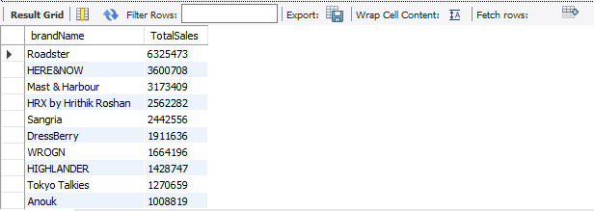
Top 10 Products by Sales

Slide 5
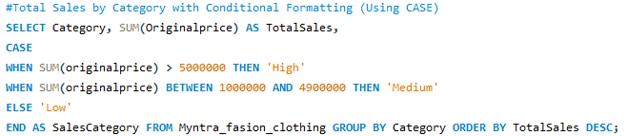
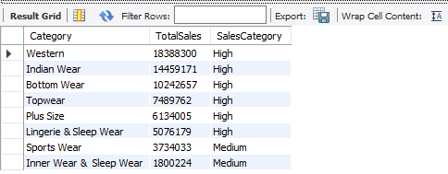
Total Sales by Category with Conditional Formatting (Using CASE)

Slide 6

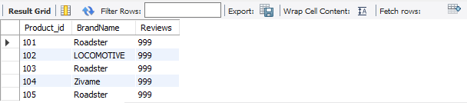
Products with the most reviews (Top 5)

Slide 7
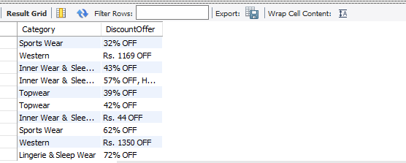
Discount offers by Category

Slide 8

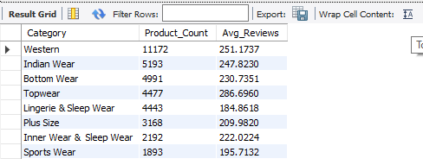
Category-wise Product Count and Average Reviews

Slide 9

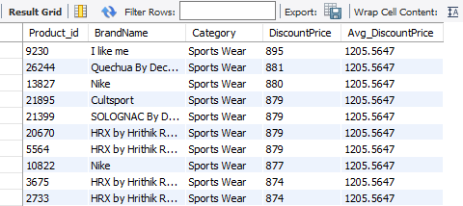
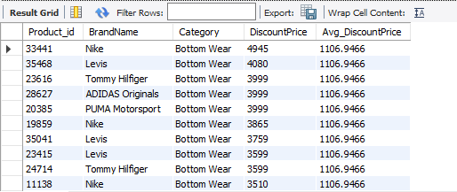
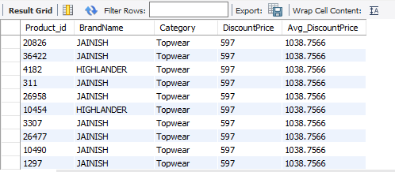
Products with Discount Price Above Average for Each Category

Slide 10
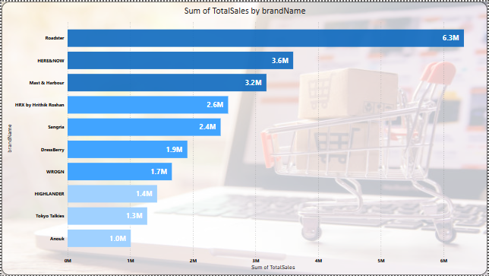
Top 10 Products by Sales

Slide 11
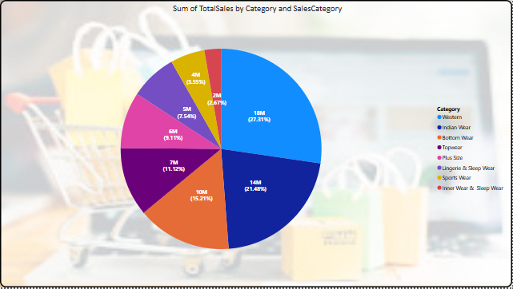
Total Sales by Category with Sales Category

Slide 12
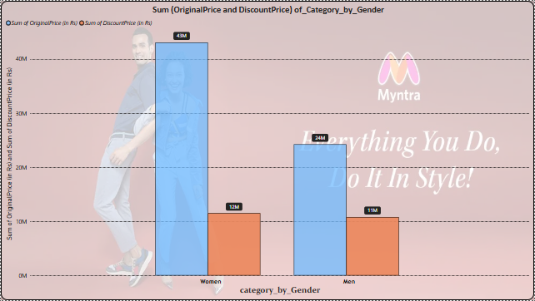
Gender wise sum of Original price and Sum of Discount Price

Slide 13
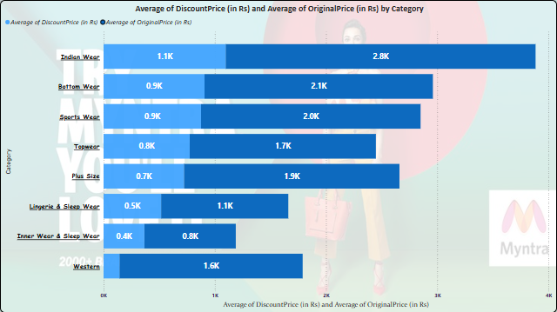
Products with Discount Price Above Average for Each Category

Slide 14
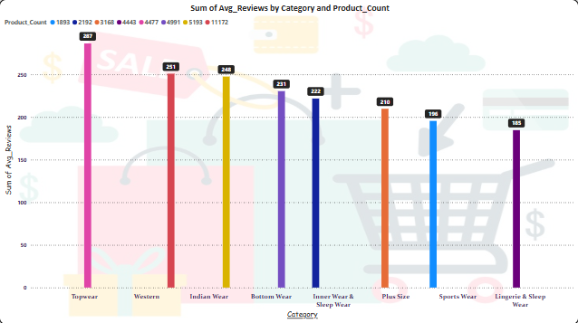
Category-wise sum of Avg Review and Product_Count

Slide 15

CONCLUSION
The analysis of Myntra's fashion data provides valuable insights into sales trends, brand performance, and customer preferences. The identification of top-selling brands, high-performing categories, and products with significant customer engagement can guide strategic decisions. Additionally, the assessment of discounts and their impact highlights areas for optimizing promotional campaigns. Overall, this study emphasizes the importance of data-driven approaches to enhance business outcomes and customer satisfaction in the competitive e-commerce fashion market.

Slide 16


THANK
YOU

